Slide 1

Exception and Error Handling
.Net / Microsoft dynamics 365

Slide 2
The C# language's exception handling features help you deal with any unexpected or exceptional situations that occur during runtime. Exception handling uses the try, catch, and finally keywords to try actions that may not succeed, to handle failures when you decide that it is reasonable to do so, and to clean up resources afterward.
https://docs.microsoft.com/en-us/dotnet/csharp/programming-guide/exceptions/exception-handling

Slide 3
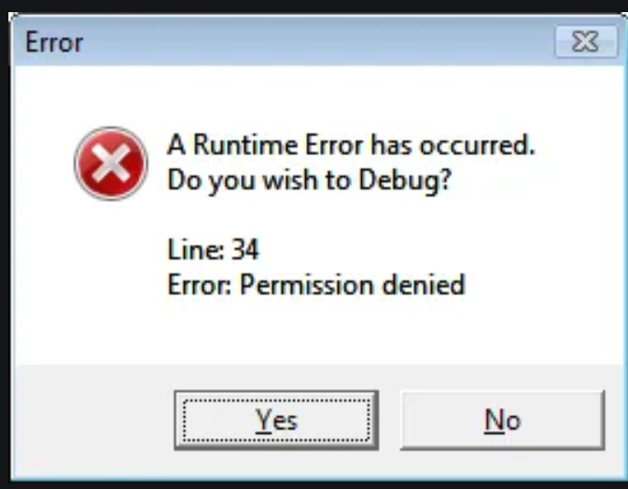
Exceptions and Errors – The Difference https://docs.microsoft.com/en-us/dotnet/api/system.exception?view=netframework-4.8#errors-and-exceptions
Run-time errors can occur for a variety of reasons. However, not all errors should be handled as exceptions in your code. There are three main types of run-time errors:
Usage Errors
An error in program logic that should be addressed not through exception handling but by modifying the faulty code.
Program Errors
a run-time error that cannot necessarily be avoided by writing bug-free code.
System Failures
a run-time error that cannot be handled programmatically in a meaningful way.

Slide 4
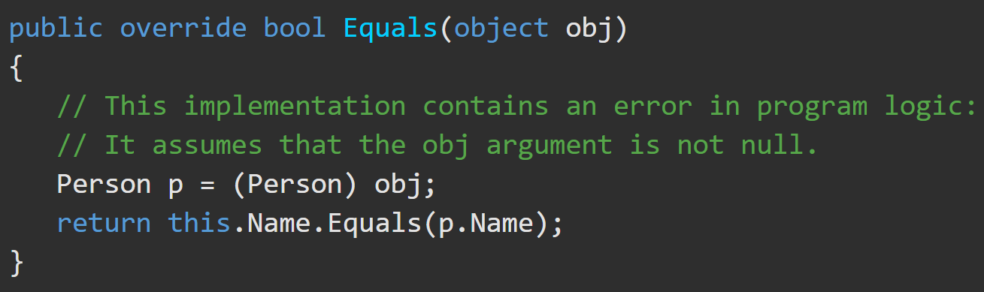
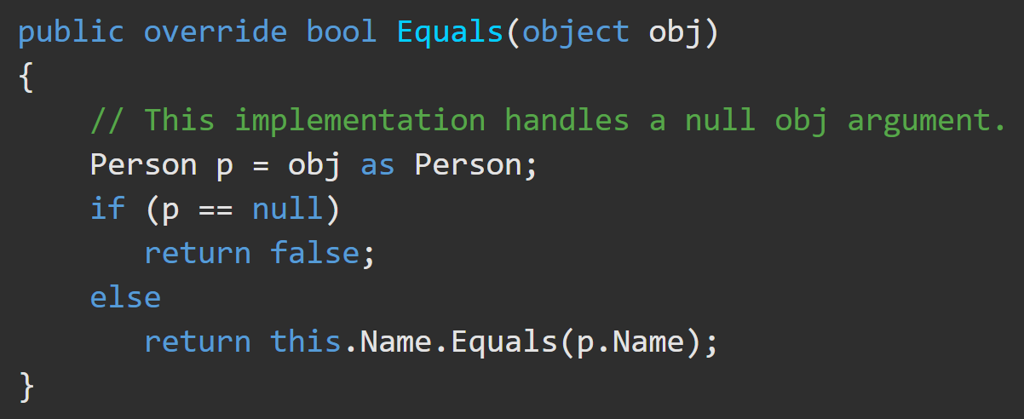
Errors – Usage Errors https://docs.microsoft.com/en-us/dotnet/api/system.exception?view=netframework-4.8#errors-and-exceptions
Usage errors occur due to faulty program logic and should be address though correction of the code rather than in handling an exception when it’s thrown.
The override of the Object.Equals(Object) method in the following example assumes that the obj argument must always be non-null.

Slide 5
Errors – Program Errors and System failures https://docs.microsoft.com/en-us/dotnet/api/system.exception?view=netframework-4.8#errors-and-exceptions
Program Errors –
may reflect a routine error condition. Avoid using exception handling to deal with program errors. Instead prevent the exception by trying the action first.
USE => DateTime.TryParseExact (returns a Boolean)
DO NOT USE => DateTime.ParseExact (throws a FormatException exception)
System failures –
should not be handled by using exception handling. Any method can throw an OutOfMemoryException exception if the CLR is unable to allocate additional memory. You may be able to use an event such as AppDomain.UnhandledException and call the Environment.FailFast method notify the user before the application terminates.

Slide 6
Exception Class https://docs.microsoft.com/en-us/dotnet/csharp/programming-guide/exceptions/
The Exception Class is the base class for all exceptions. It represents errors that occur during application execution. When any error occurs, the system or the application throws an exception that contains information about the error.
When an exception is thrown by a method far down the call stack, the CLR will unwind the stack, looking for a method with a catch block for the specific exception type. It will execute the first such catch block that if finds. If it finds no appropriate catch block anywhere in the call stack, it will terminate the process and display a message to the user.

Slide 7
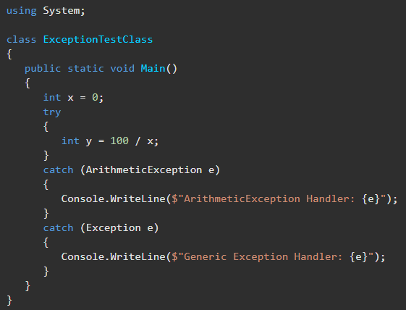
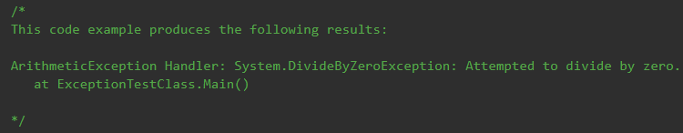
Exceptions – Example https://docs.microsoft.com/en-us/dotnet/api/system.exception?view=netframework-4.8#examples
This catch block will handle ArithmeticException errors. The catch block also catches DivideByZeroException errors, because DivideByZeroException derives from ArithmeticException. Without the exception handling, this program would terminate with a ‘DivideByZeroException was unhandled’ error.

Slide 8
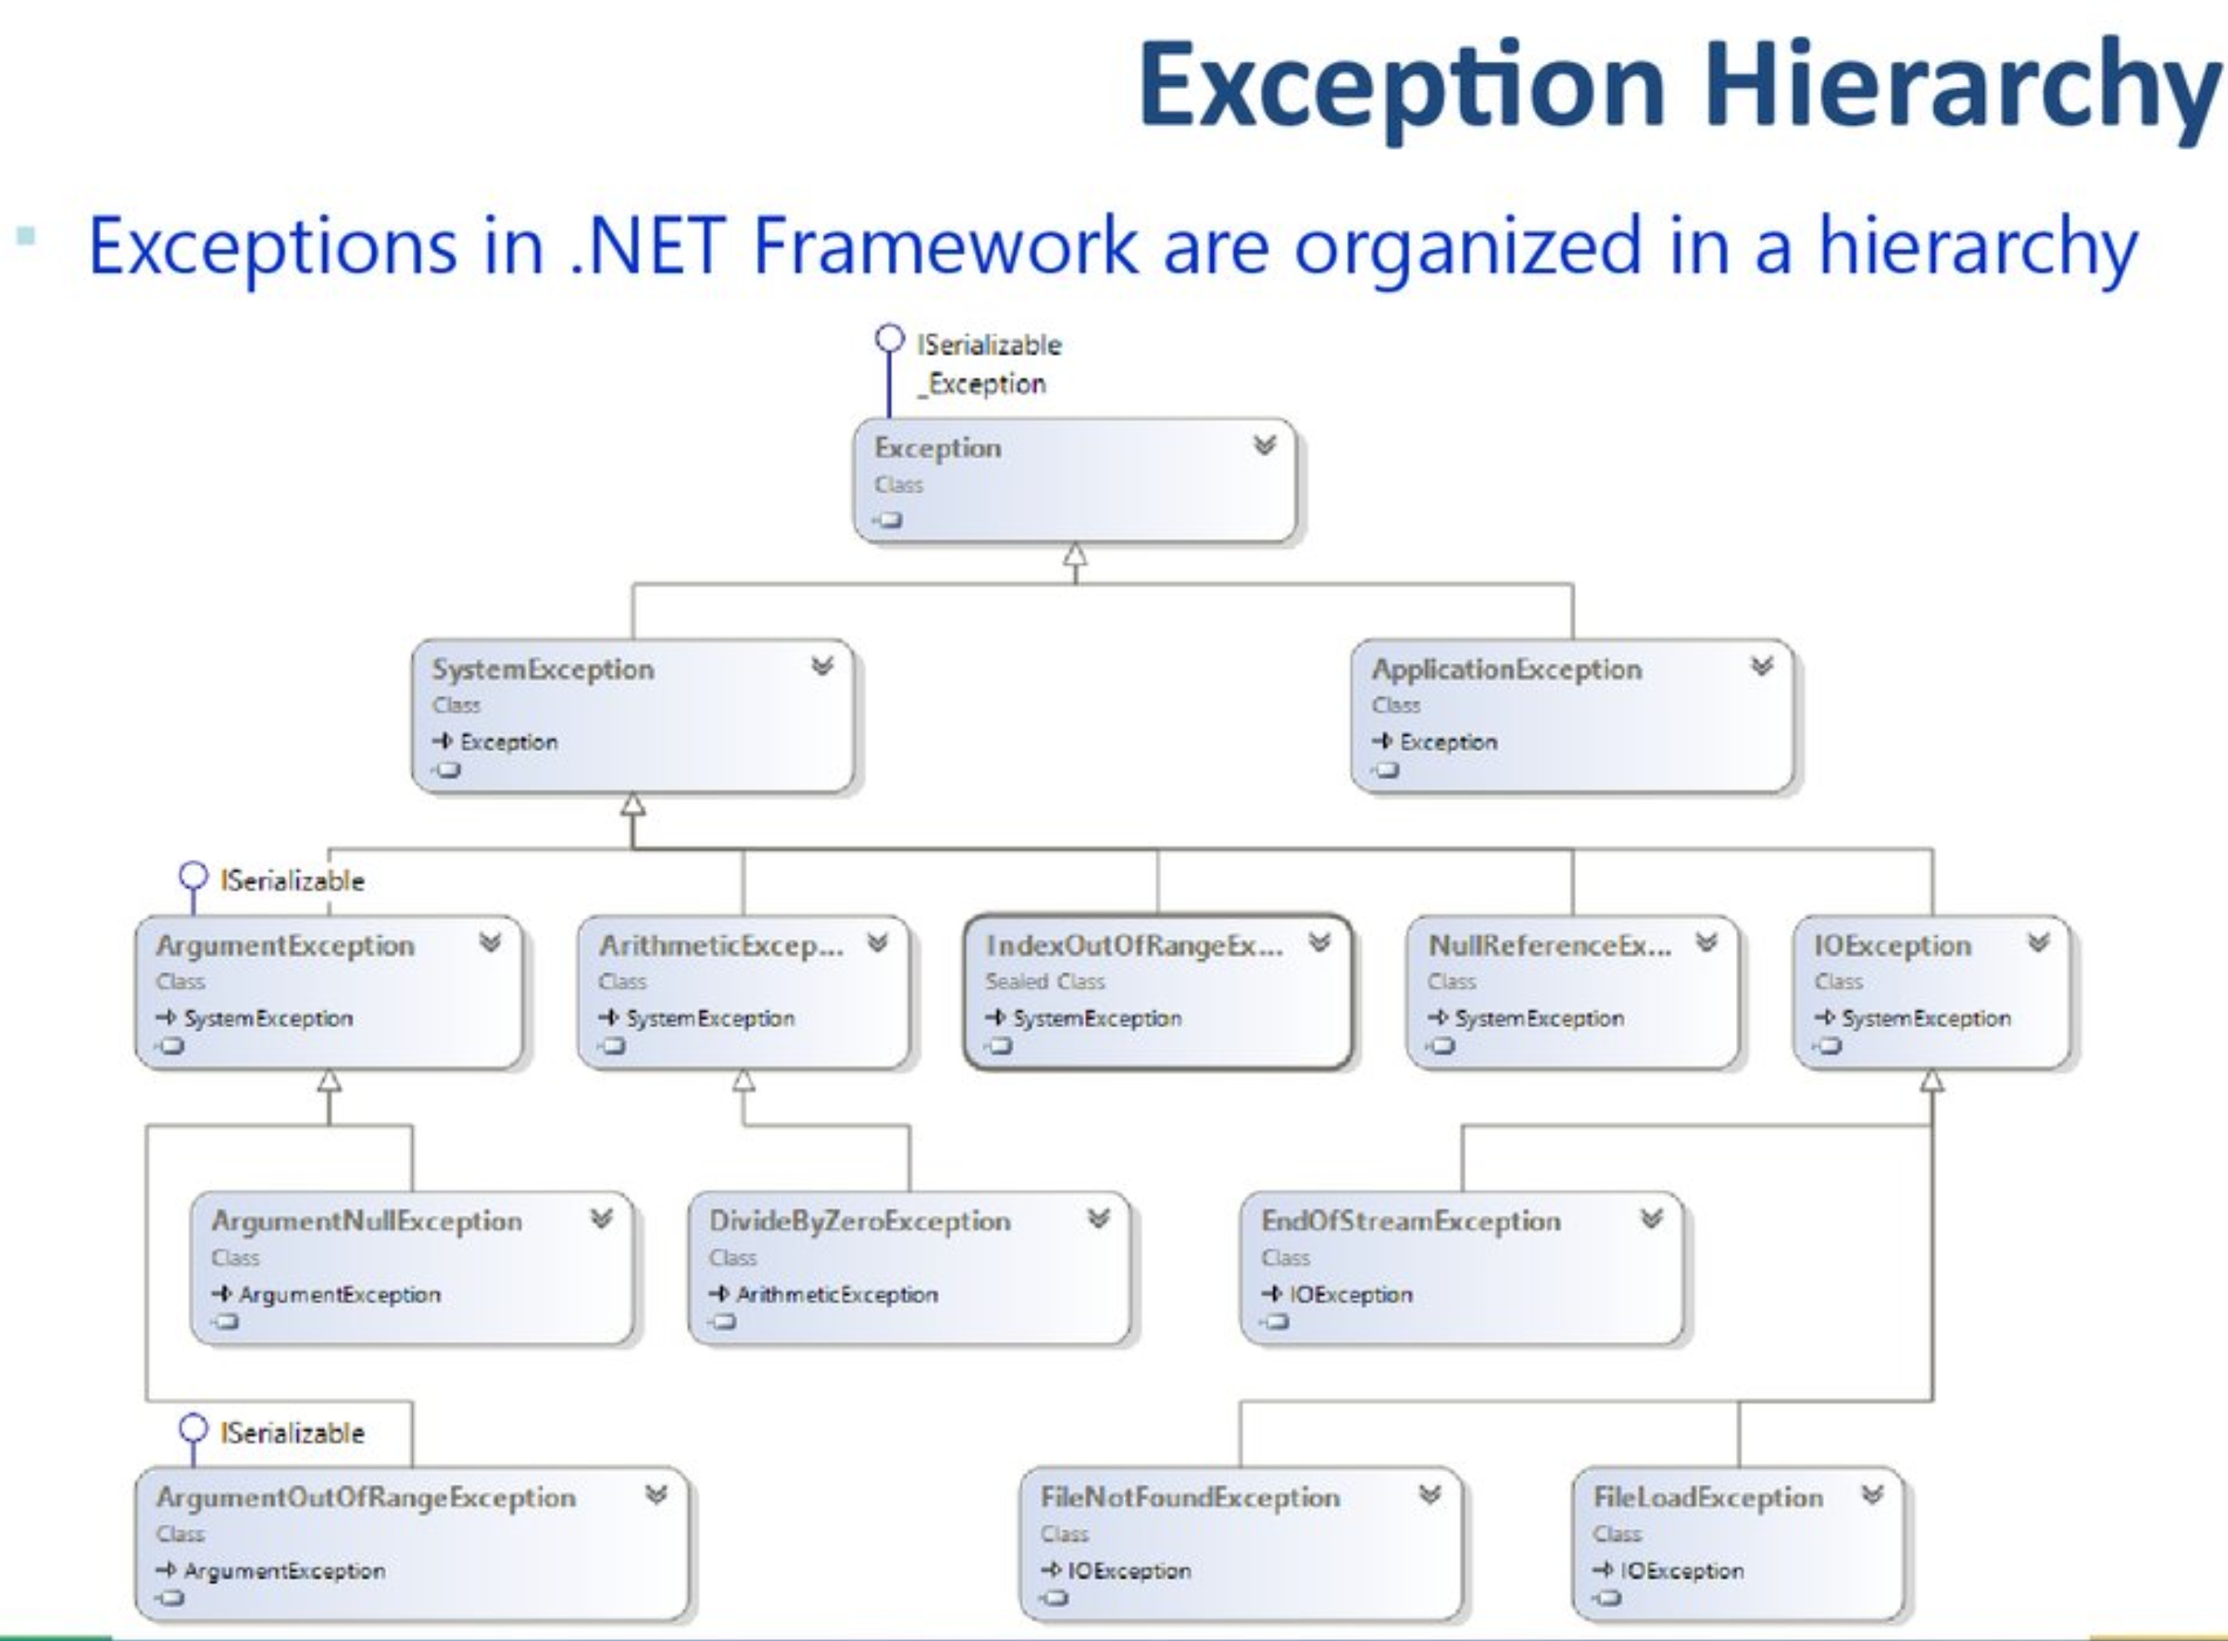
Exception Class – Hierarchy https://en.ppt-online.org/89884
All exceptions inherit from the Exception Class. All run-time exceptions inherit from the SystemException Class.

Slide 9
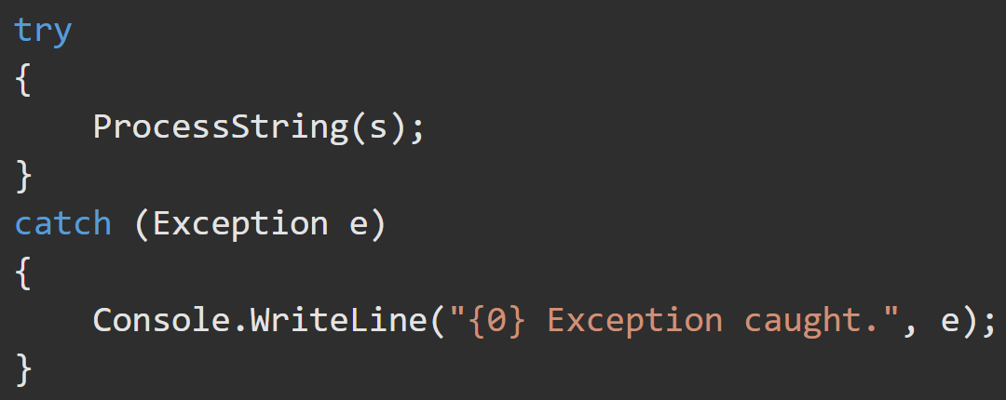
Exceptions – Try/Catch Block https://docs.microsoft.com/en-us/dotnet/csharp/language-reference/keywords/try-catch
Generally, when an exception is thrown, the CLR unwinds the stack looking for the appropriate catch statement. If no catch block is found, then the CLR displays an unhandled exception message to the user and stops execution of the program.
The try/catch statement consists of a try block followed by one or more catch clauses, which specify handlers for different exceptions. The try block contains the guarded code that may cause the exception. The block is executed until an exception is thrown or it is completed successfully.
Using multiple catch arguments is a way to filter for the exceptions you want to handle.

Slide 10
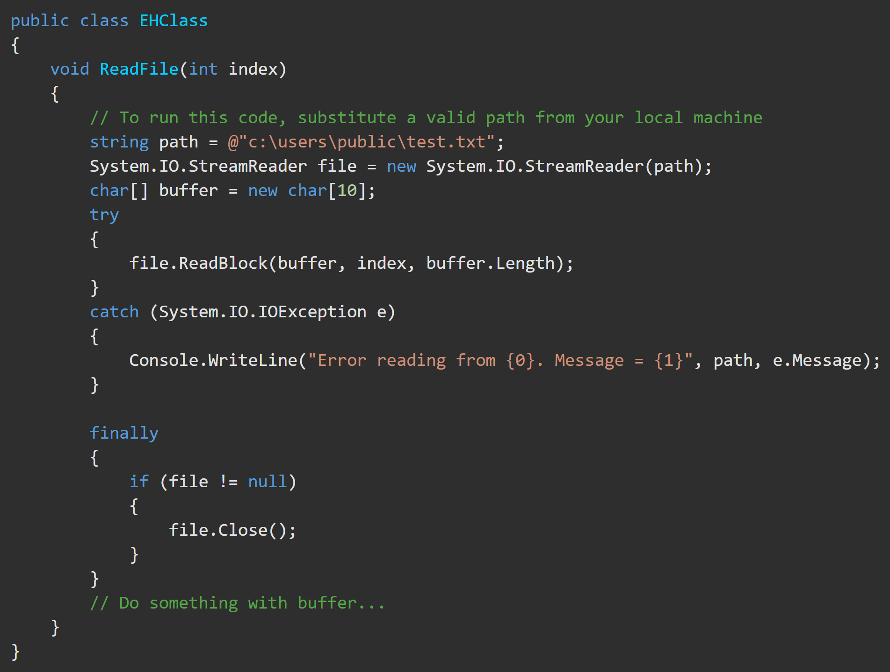
Exceptions - Try/Catch/Finally https://docs.microsoft.com/en-us/dotnet/csharp/language-reference/keywords/try-catch-finally
Usage of try/catch/finally block is to
obtain and use resources in a try block,
deal with exceptional circumstances in a catch block, and
release the resources in the finally block.
The finally block always runs.

Slide 11
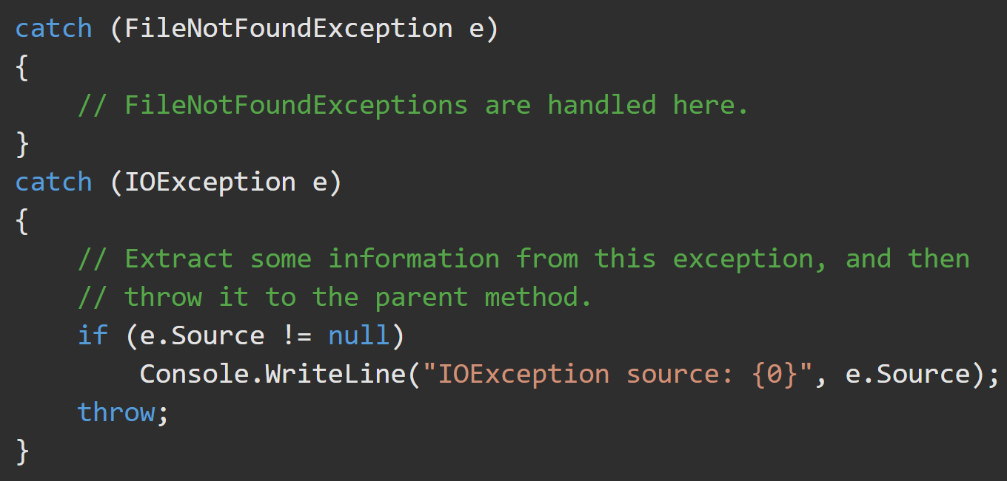
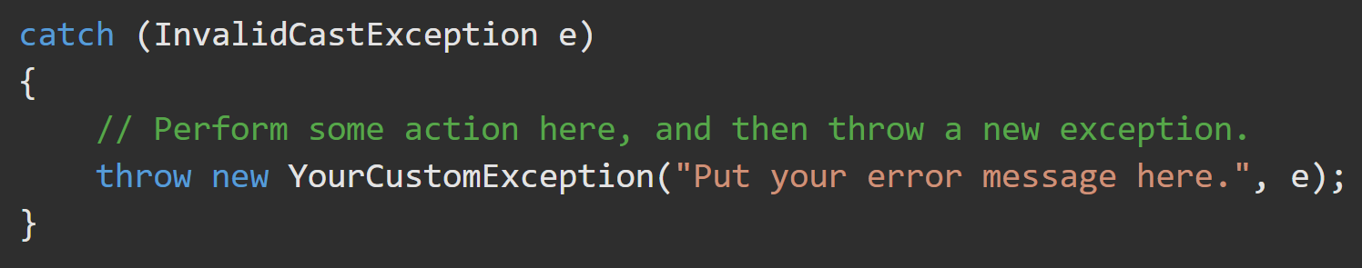
Exceptions - Throw https://docs.microsoft.com/en-us/dotnet/csharp/language-reference/keywords/throw https://docs.microsoft.com/en-us/dotnet/csharp/language-reference/keywords/try-catch
A throw statement can be used in a catch block to re-throw the exception that is caught by the catch statement. The following example extracts source information from an IOException exception, and then throws the exception to the parent method.
You can catch one exception and throw a different exception. When you do this, specify the exception that you caught as the inner exception, as shown in the following example.

Slide 12
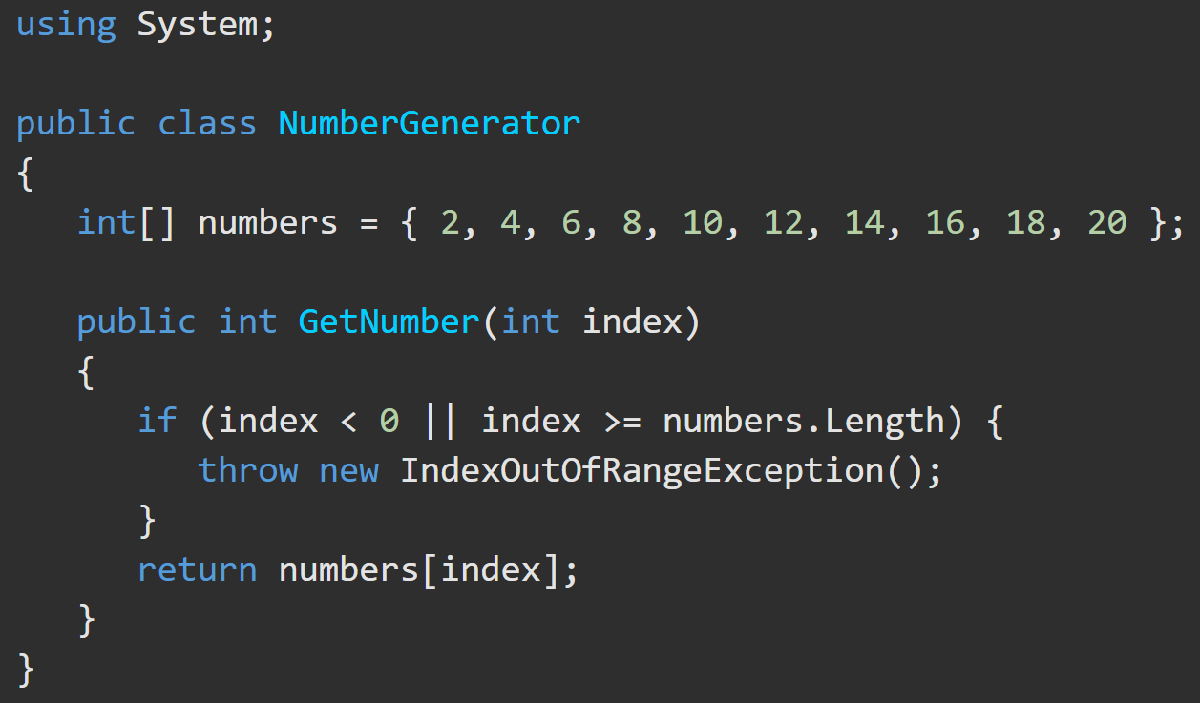
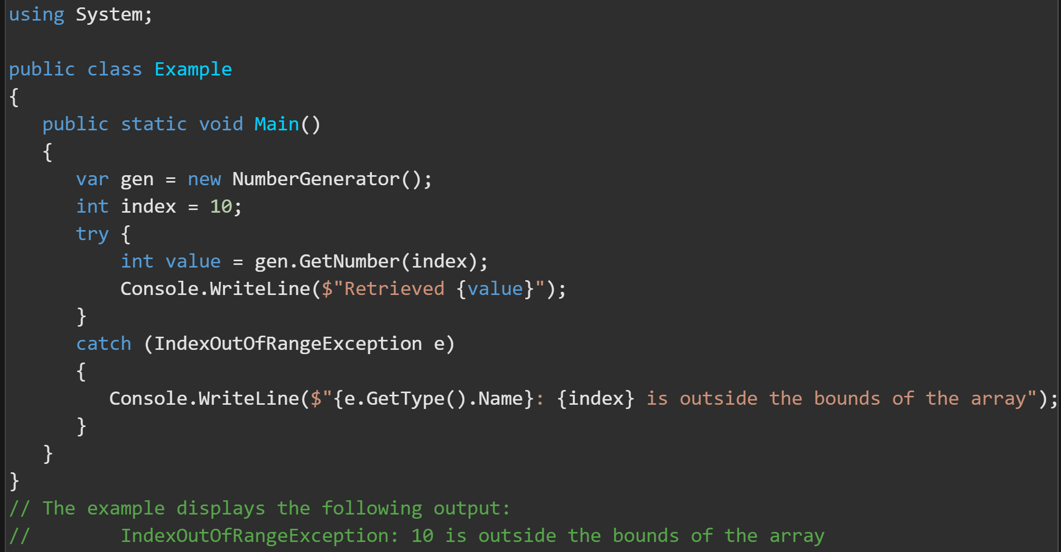
Exceptions – Throw and Unwind The Stack https://docs.microsoft.com/en-us/dotnet/csharp/language-reference/keywords/throw

Slide 13
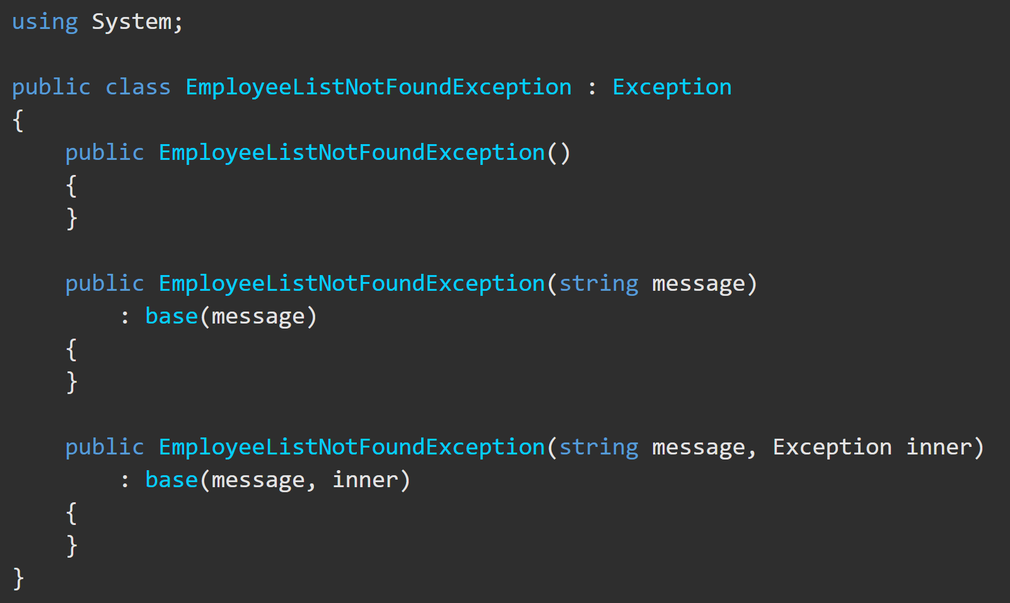
User-Defined Exceptions https://docs.microsoft.com/en-us/dotnet/standard/exceptions/how-to-create-user-defined-exceptions
If none of the predefined exceptions from the exception hierarchy meets your needs, you can
create your own exception classes
Derive(inherit) from the Exception class.
End the class name with the word "Exception“.
Implement the three common constructors(example).
The example defines a new exception class named EmployeeListNotFoundException. The class is derived from Exception and includes three constructors.

Slide 14
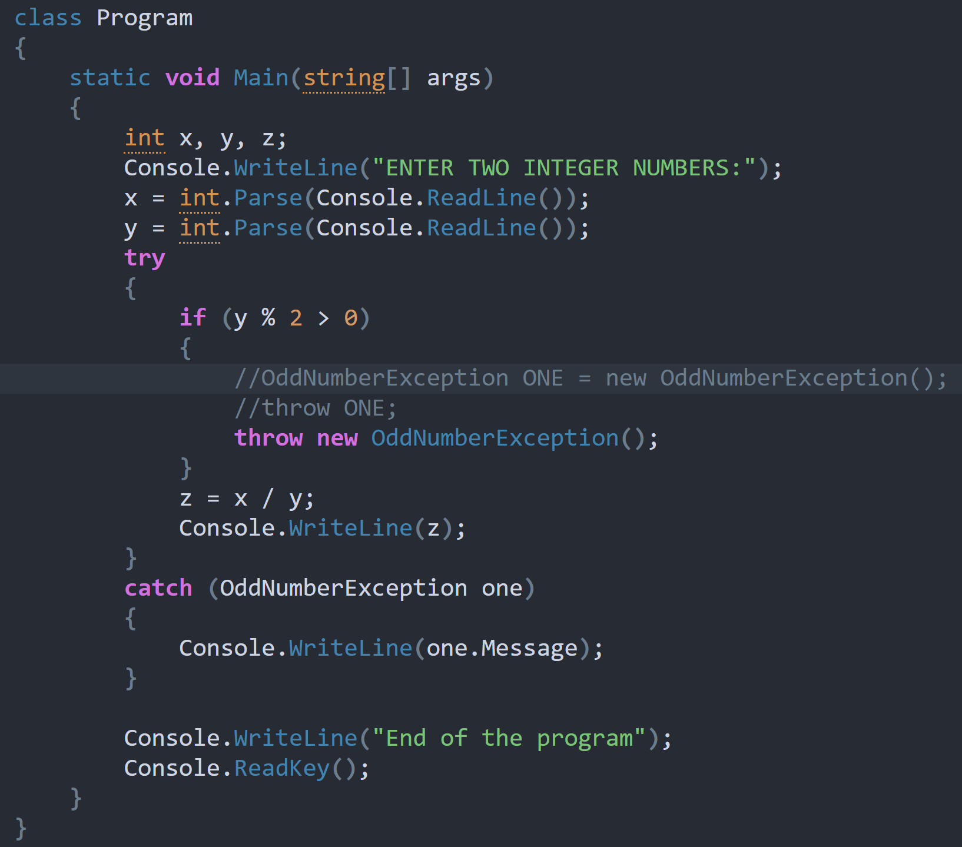
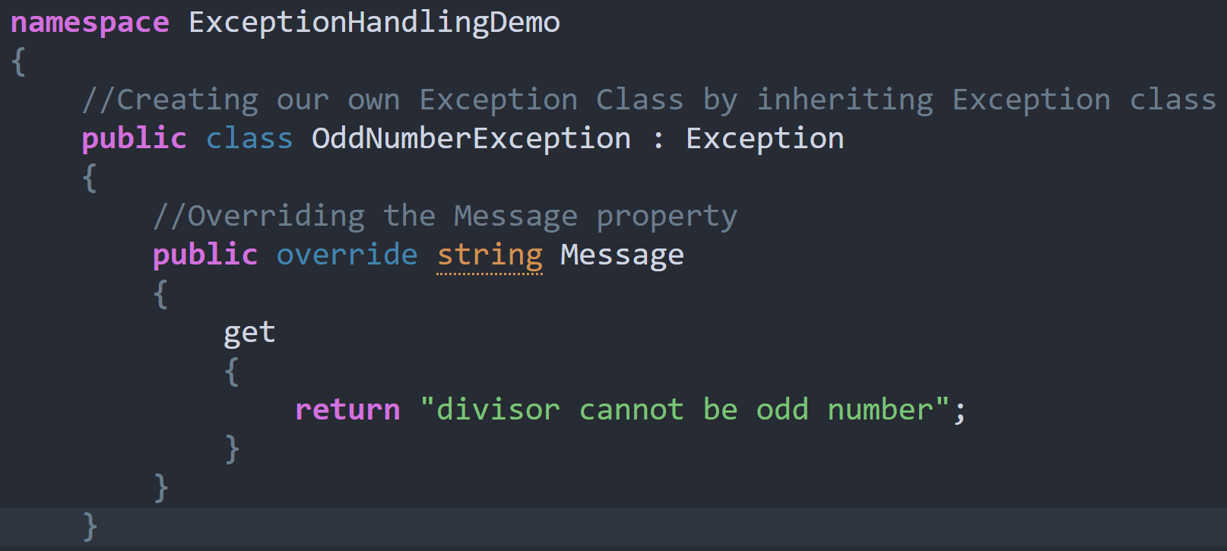
User-Defined Exceptions https://dotnettutorials.net/lesson/create-custom-exception-csharp/#:~:text=
Create a new class inheriting from Exception.
Override Exception’s virtual property called message with your chosen error message.

